Slide 1

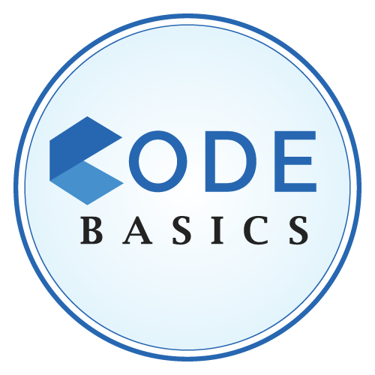
AtliQO Telecom
Presented by Shakti Singh

Slide 2
AGENDA
Company Overview
Data
Insights & Visuals

Slide 3
Company Overview
Intro :-
AtliQo Telecom - One of the leading telecom service providers in India, continuously strives to improve customer experience and offer competitive services to its user base. In May 2022, the company launched its highly anticipated 5G plans along with other telecom providers.
Problem :-
AtliQo’s management noticed a decline in both active users and revenue growth following the introduction of their 5G plans.
The business director of AtliQo requested the analytics team to investigate and produce a detailed comparison report of key performance indicators (KPIs) between the periods before and after the 5G launch. They also wonder if they can optimize their internet plans to get more active users.
The goal was to understand the underlying factors contributing to the decline and to identify potential areas for improvement.

Slide 4
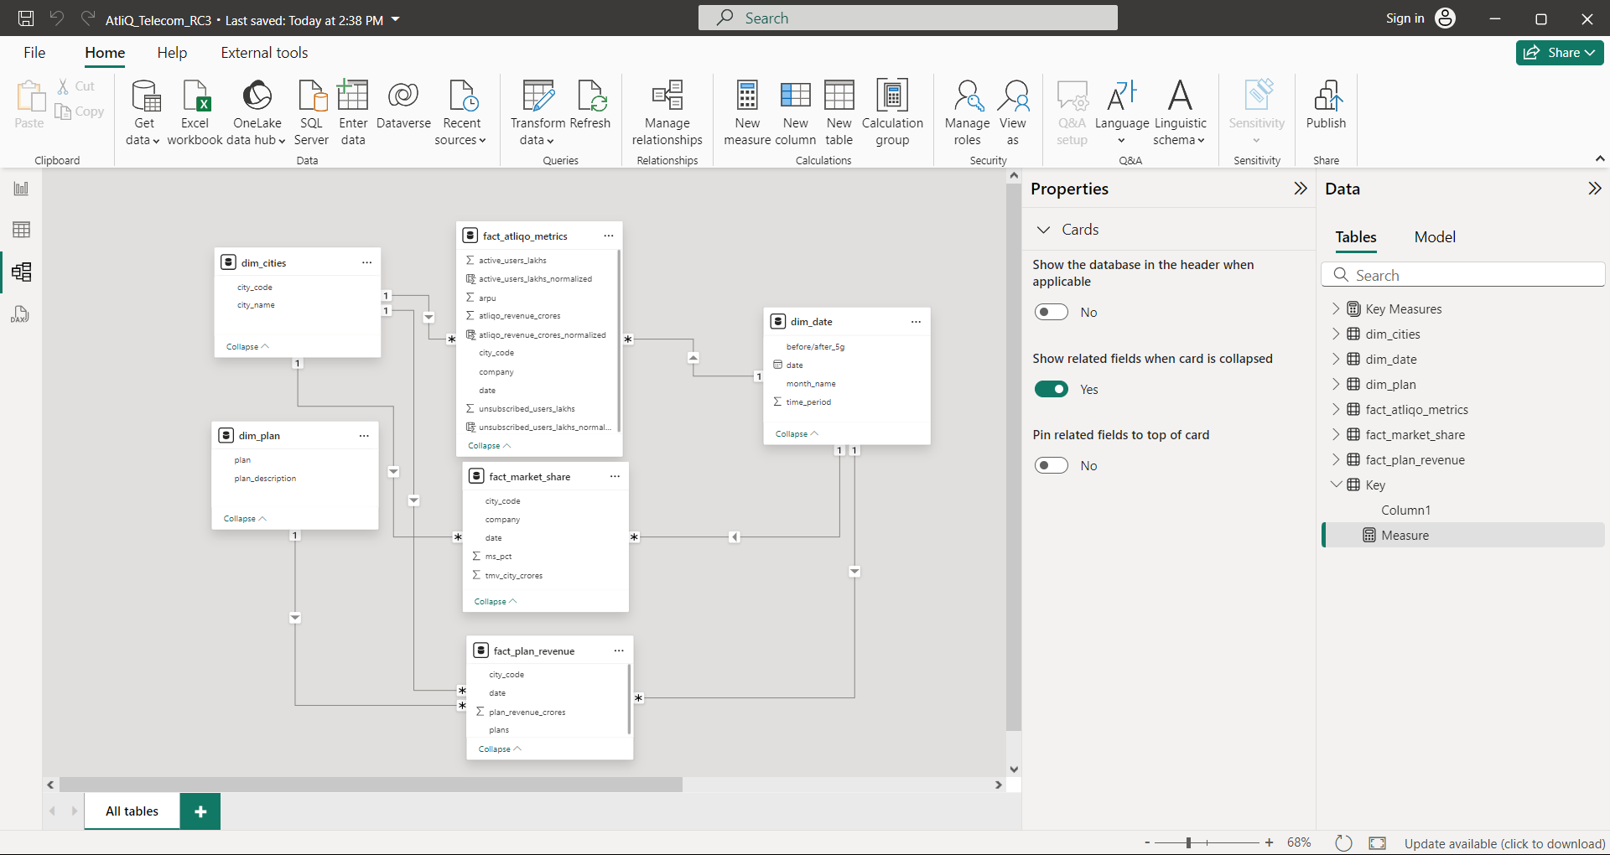

Data :
For Visuals :-
POWER BI

Slide 5
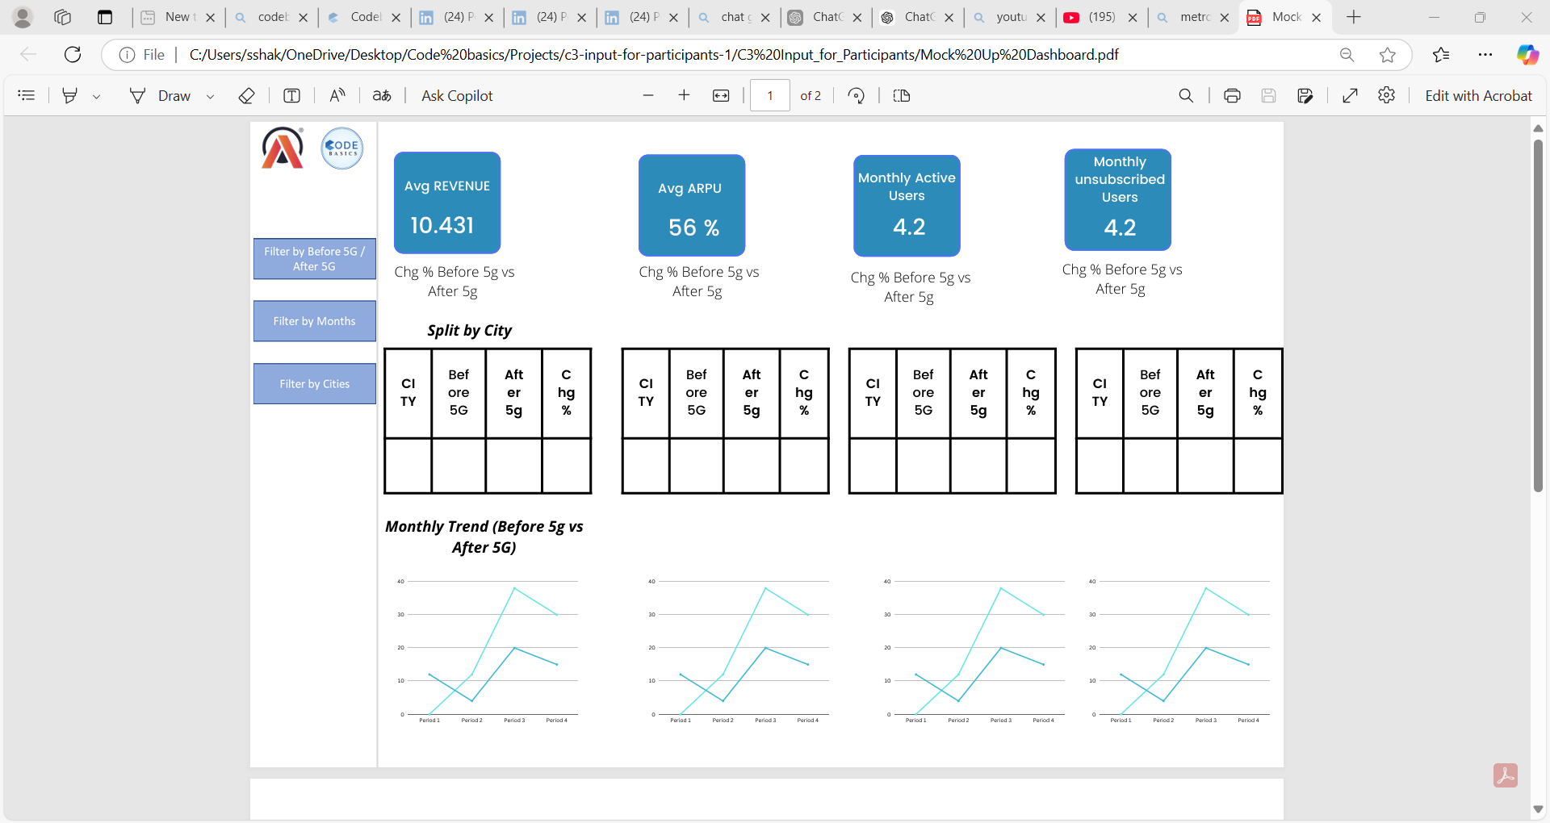
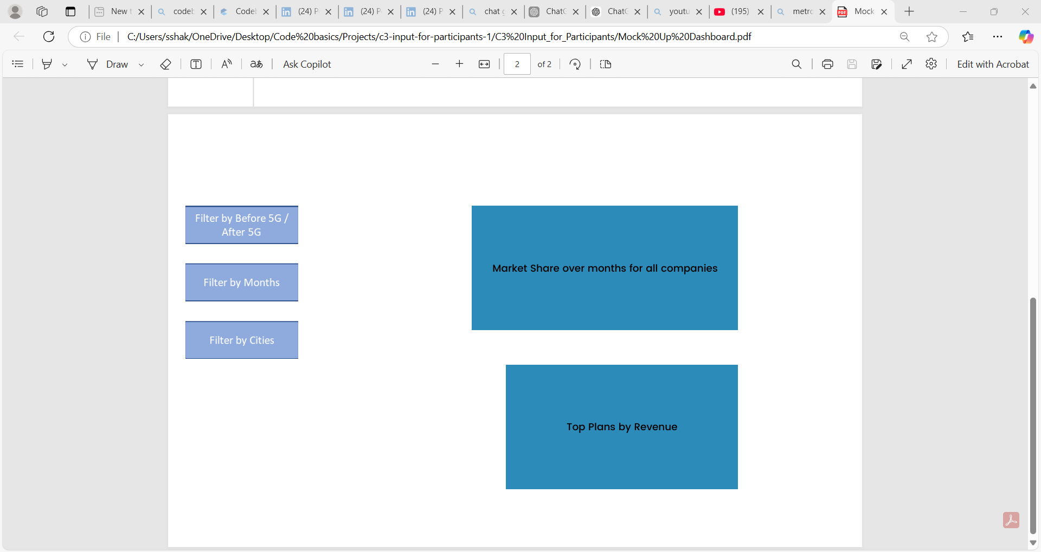
Mock Up Dashboard

Slide 6
Insights
&
Visuals
Note:
Revenue Values is in Crores.
Active Users & Unsubscribe Users in Lakhs.

Slide 7
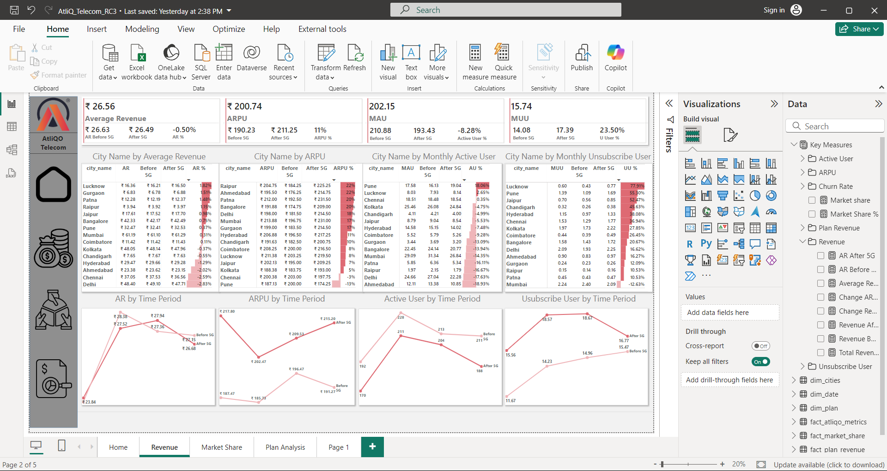

After launch of 5G there is increase in Average Revenue per user by 11% we can say that there is increase in plan rate after 5G due to the data add on features available in 5G.
After launch of 5G there is decrease in Active user by -8.28%. We can say that due to increase in plan cost, device compatibility or competitors are offering effective plan at lower cost.
After launch of 5G there is increase in Unsubscribe user by 23.50%. We can say that due to increase in plan cost, device compatibility or competitors are offering effective plan at lower cost.
After launch of 5G there is decrease in Revenue by 0.5%
After 5G , Lucknow (1.82%) has the highest revenue generated followed by Gurgaon (1.51%) , Patna (1.48%) and so on. But Delhi (-2.83%) , Chennai (-2.59%) followed by Ahmedabad , Hyderabad shows a less revenue generated (in crores).
After 5G , Raipur (22%) & Ahmedabad (22%) has the highest ARPU followed by Patna (20%) and so on . But Pune (-13%) & Chennai (-3%) shows a less ARPU (Average revenue per user) (in crores).
After 5G , Pune (18.06%) & Lucknow (2.65%) has the highest Active User followed by Chennai . But Ahmedabad (-18.93%) , Delhi (-17.63%) and so on shows least active user(in lakhs) .
After 5G , Lucknow (77.91%) , Pune (55.30%) has the highest Unsubscribe user followed by Jaipur (52.47%) and so on . But Mumbai (-12.63%) has least Unsubscribe user (in lakhs).

Slide 8
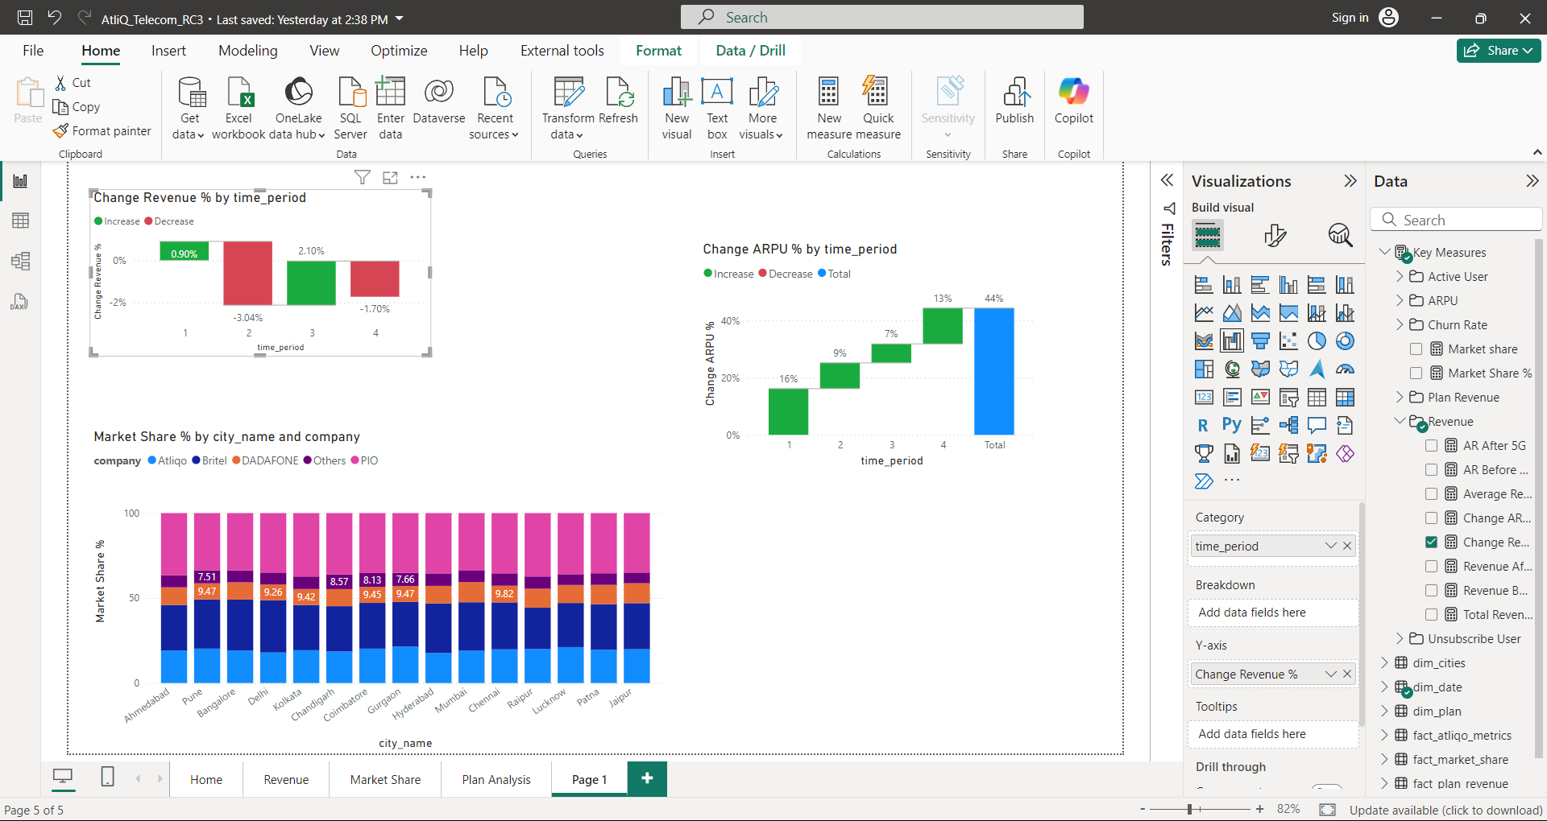
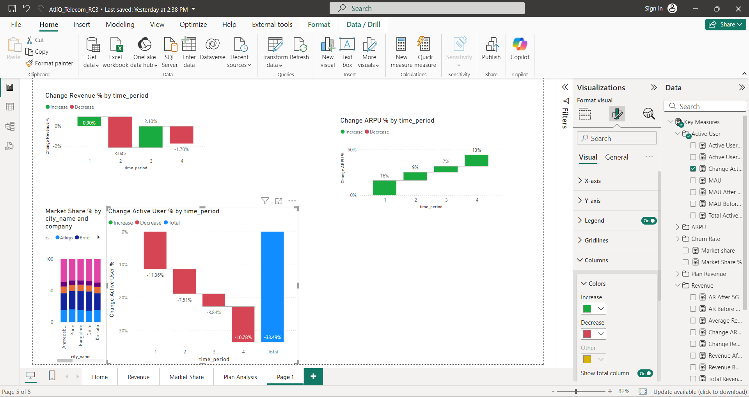
After 5G there is increase in revenue for 1st month b 0.9% but following months revenue is dropped by 3.04% and again it increase by 2.10% again get dropped by 1.70% so we say that after launch of 5G AtliQo revenue is fluctuating or inconsistent.
After 5G launch there is consistently increase in Average revenue per user these due to increase in plan cost , giving add on with IOT services

Slide 9

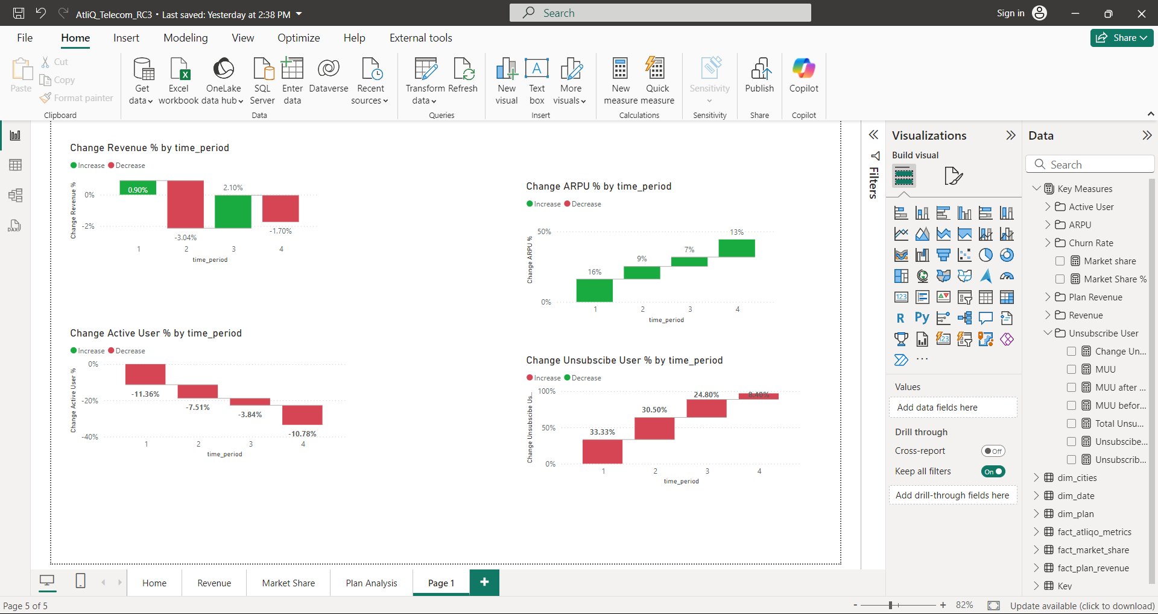
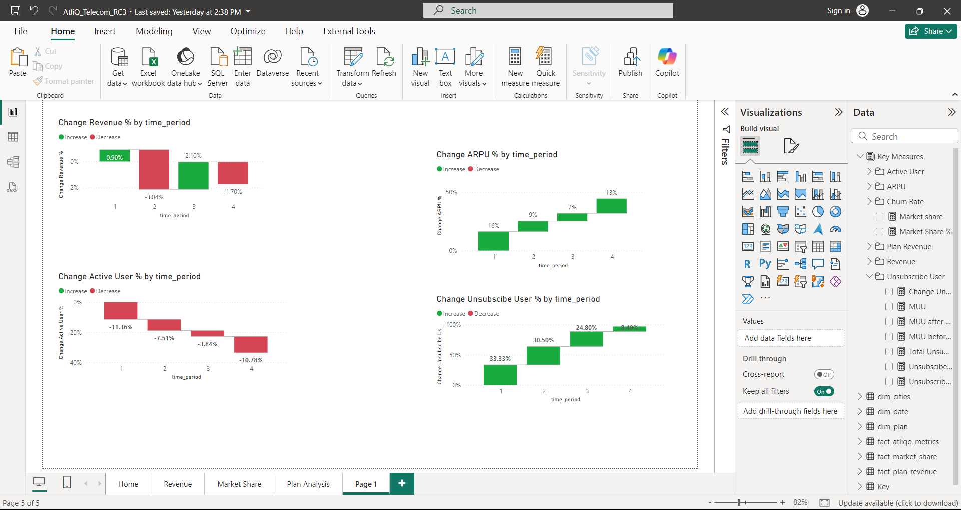
After 5G there is huge drop in active users as compare to previous services.
Atliqo need to provide effective plan for users as compared to competitor companies to increase there active user base
After 5G launch there is increase in unsubscribe user but as month pass we can see drop in unsubscribe users.

Slide 10
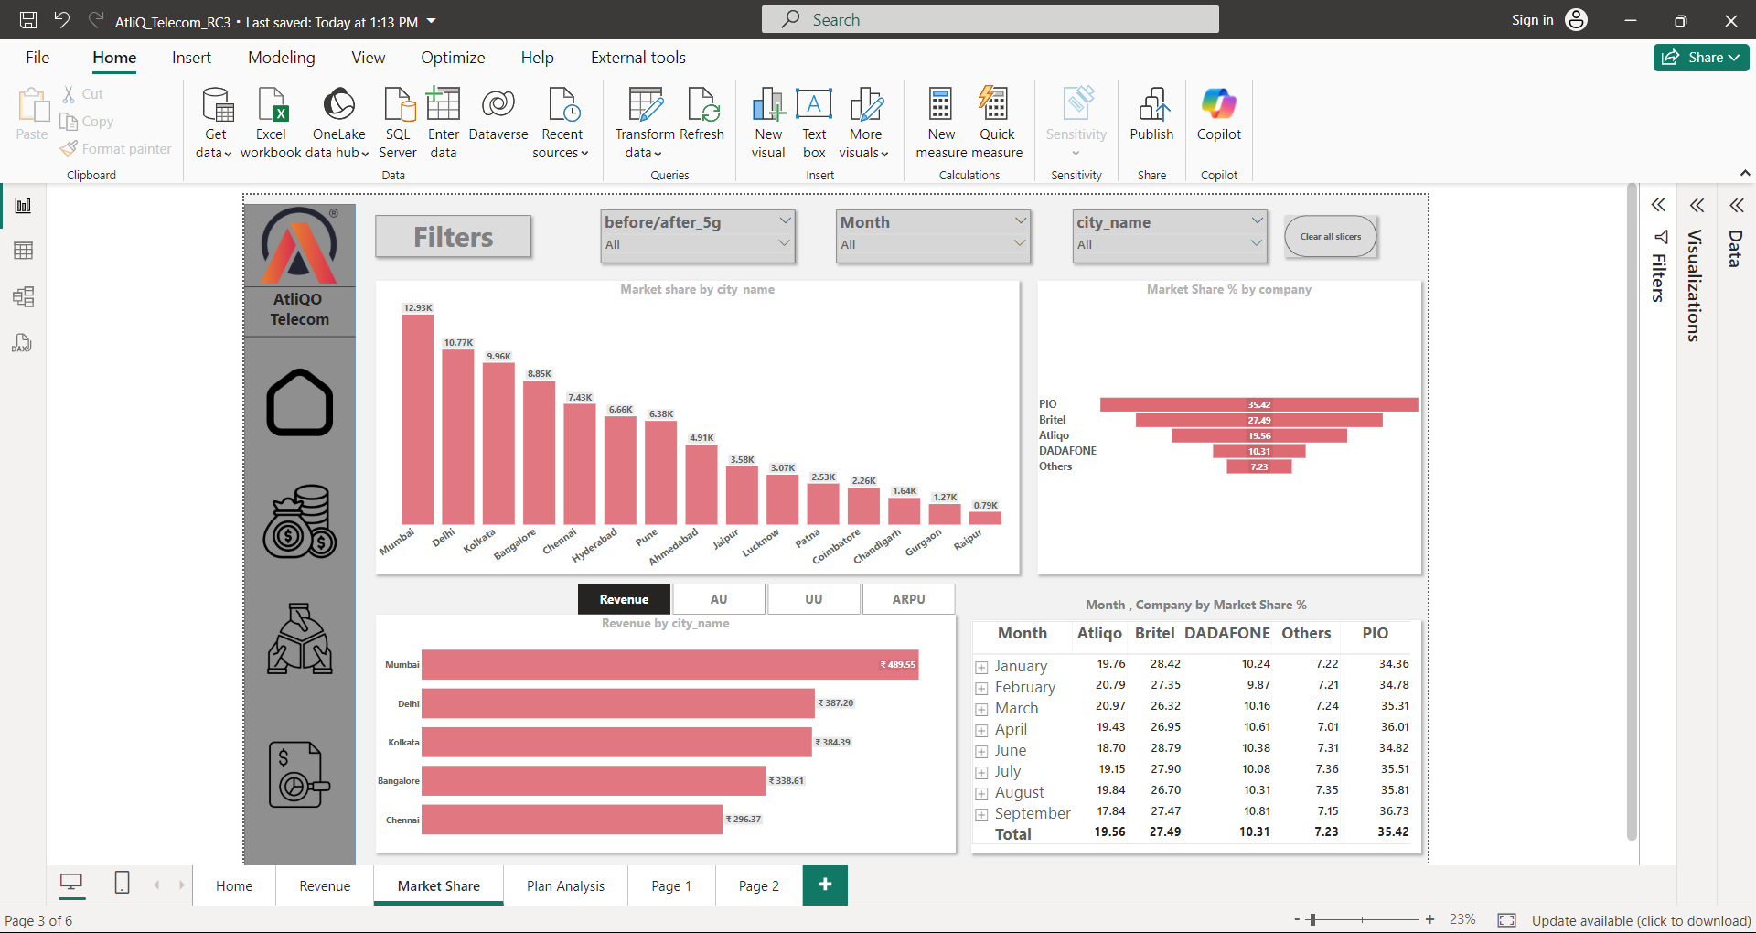

Atliqo is at the 3rd position in terms of market share % with 19.56 % indicates the strong relatively strong position in market. By focusing on various factors like focusing on customer acquisition by attractive pricing , innovating products, Enhance user experience by giving better customer services.
In terms of Total Market Share Mumbai has the highest Market share followed by Delhi, Kolkata, Bangalore, Chennai, Hyderabad (i.e. Metro cities).
But Raipur , Gurgaon, Chandigarh has the least market share.

Slide 11
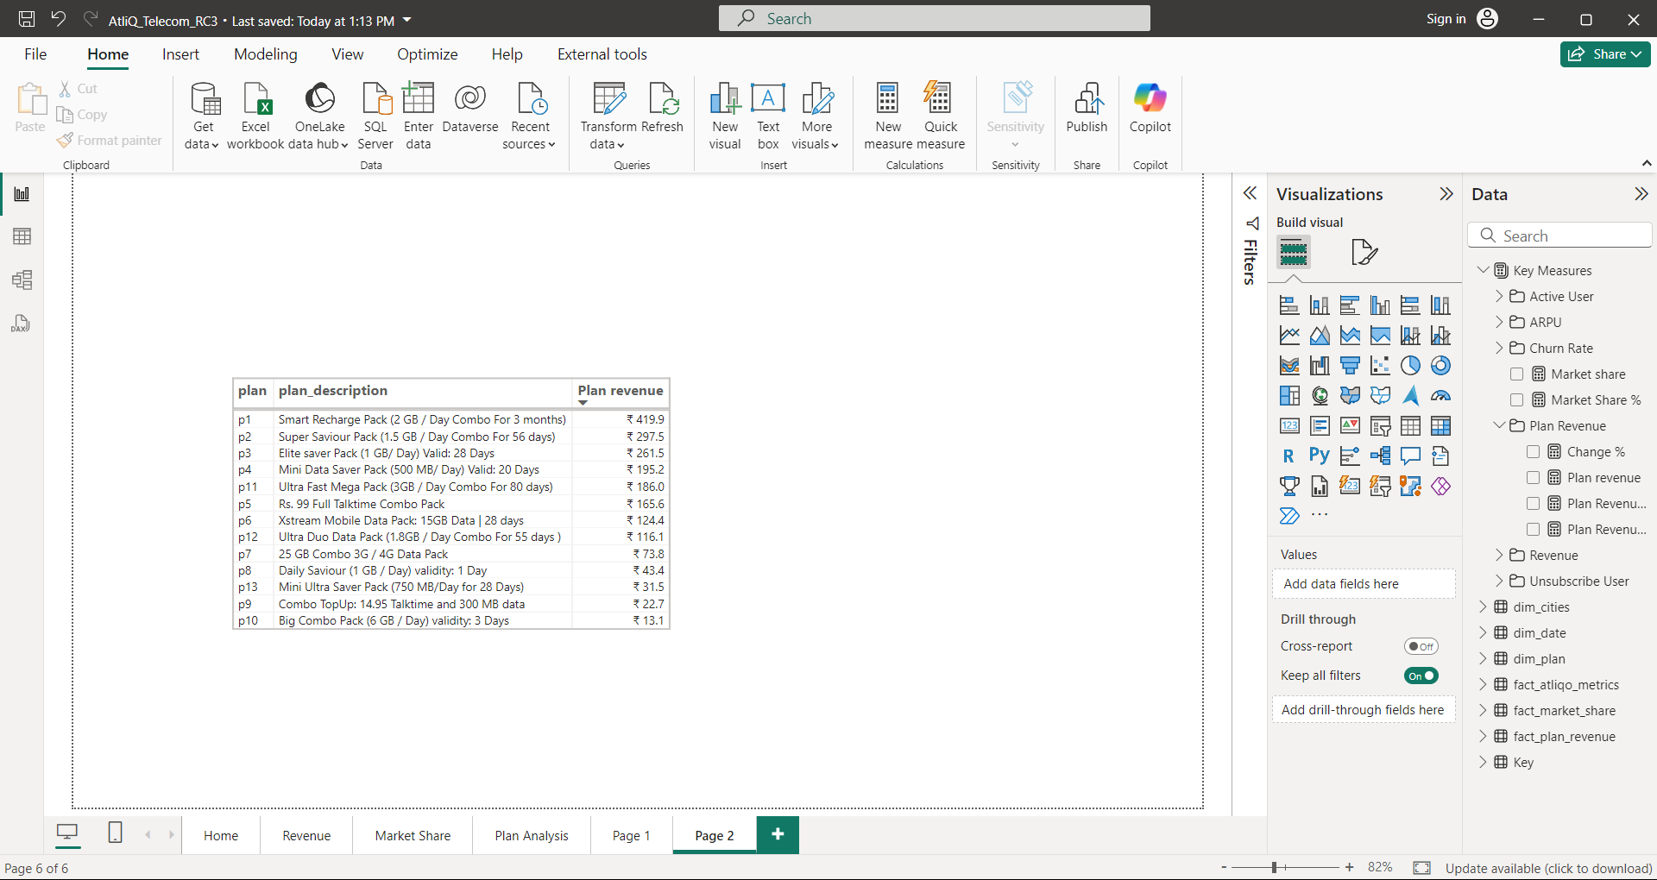
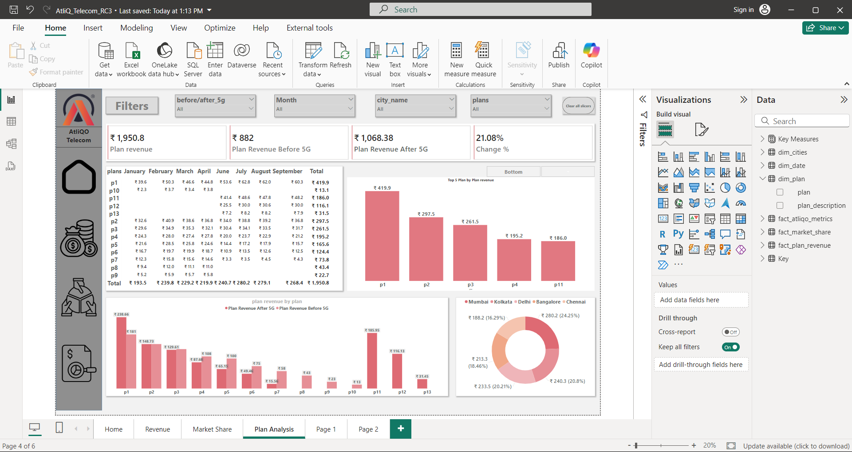
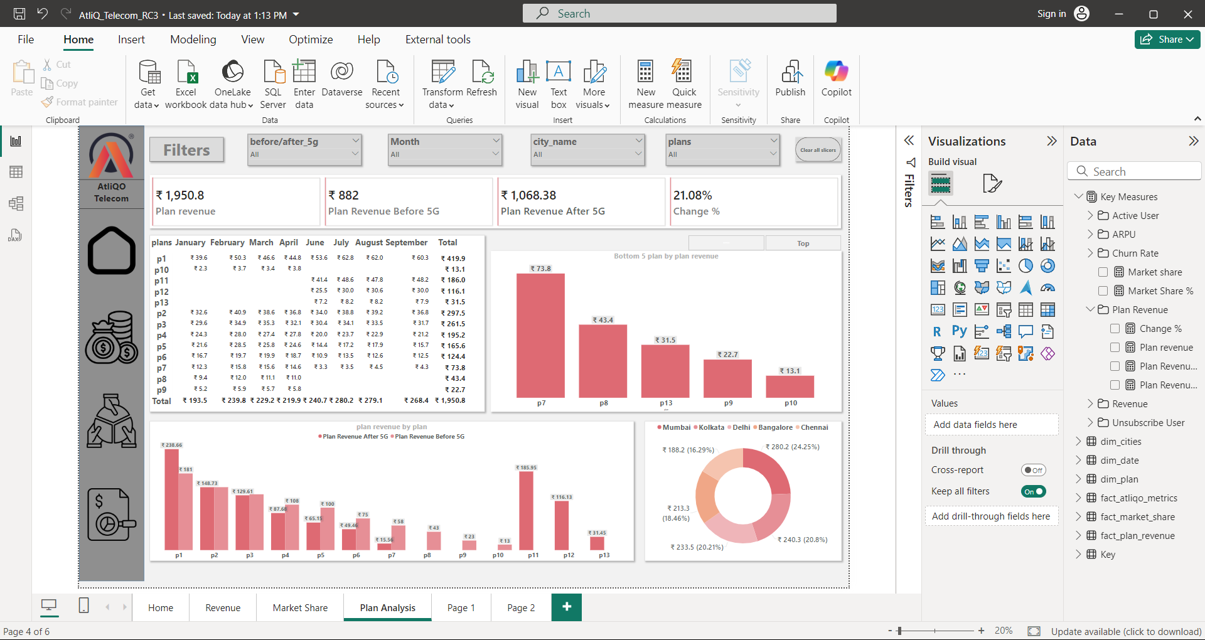
These are the Plans & there description with plan revenue.
Plan p1 has the highest plan revenue followed by p2, p3, p4, p11 (all values are in Crore).
Plan p10 has the lowest plan revenue followed by p9, p13, p8, p7 (all values are in Crore).

Slide 12
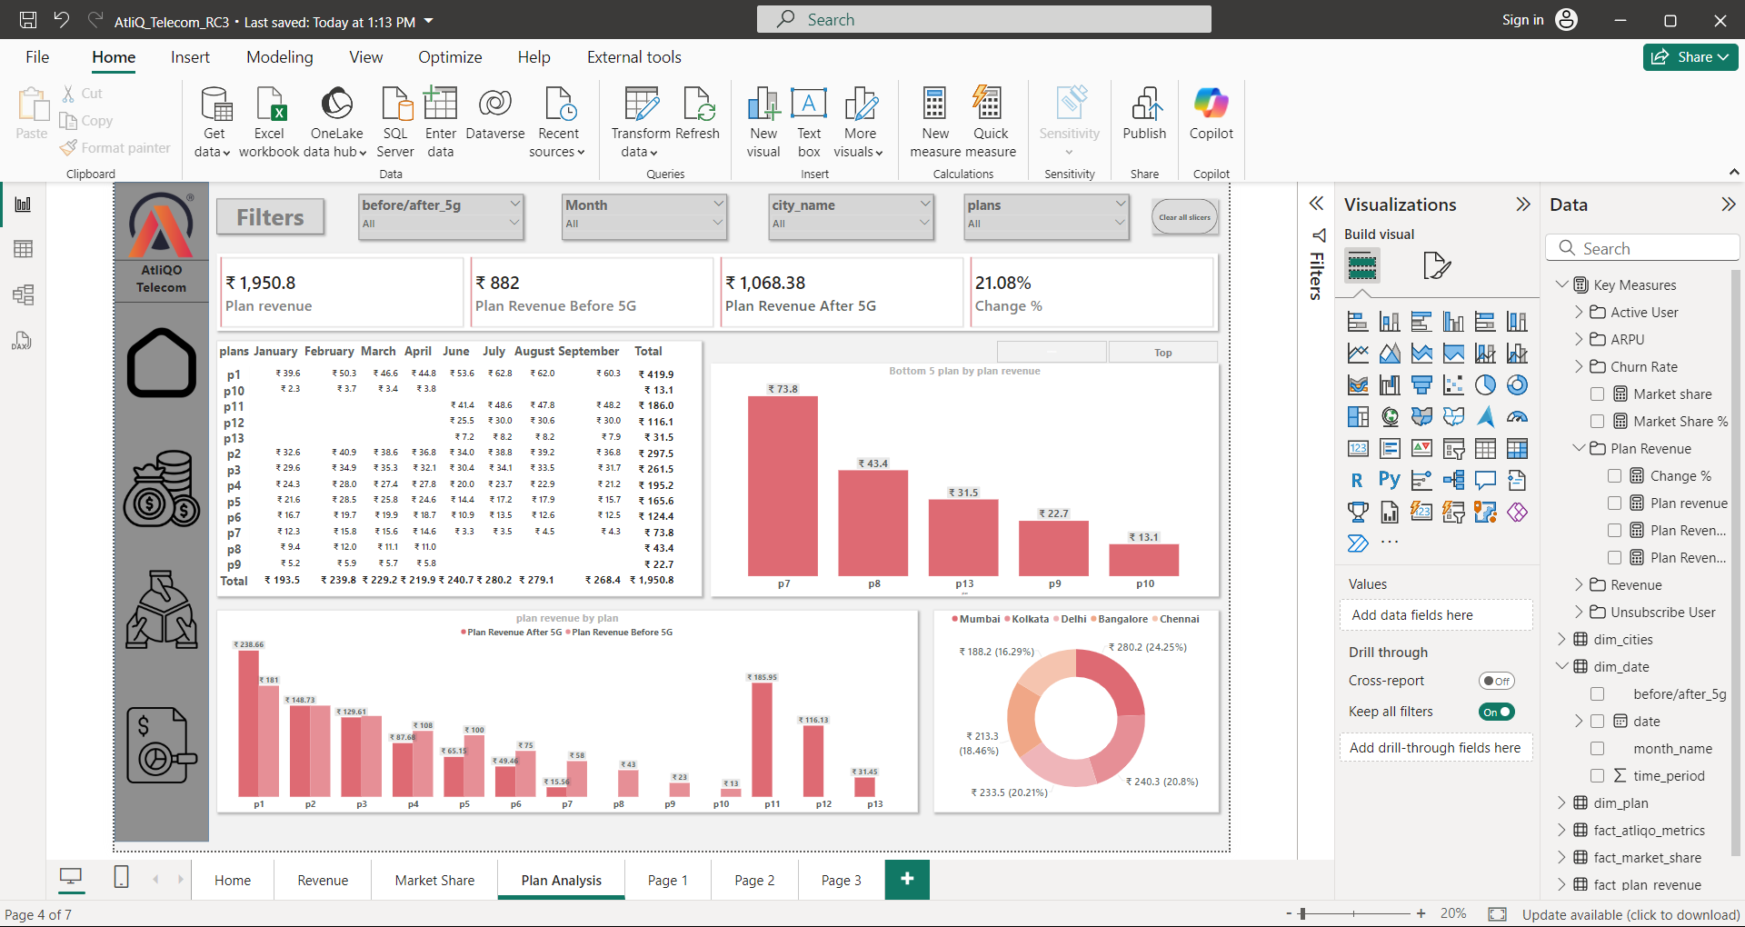
Top 5 cities by plan revenue Mumbai is the highest in terms of plan revenue as followed by Kolkata, Delhi, Bangalore, Chennai.
Plan P1 has shown significant performance after the 5G launch, followed by P2, P3, P4, and so on.
Plans P8, P9, and P10 were discontinued after the 5G launch.
Plans P11, P12, and P13 are new plans launched after 5G; among these, P11 is the highest performer, followed by P12, while P13 is the least performer.
Among all the plans, we see that P1, P2, P3, P4, and P11 have the highest revenue, as these plans include combo packs with an effective price.
For Atliqo to increase their revenue or customer base, they need to introduce more combo packs, as customers are more interested in these offerings.

Slide 13
Thank You

